Slide 1
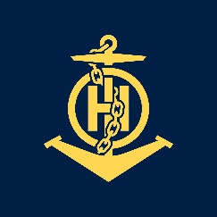
Captain
IHO – NIPPON FOUNDATION
ALUMNI SEMINAR
NIKI SILVERA

Slide 2
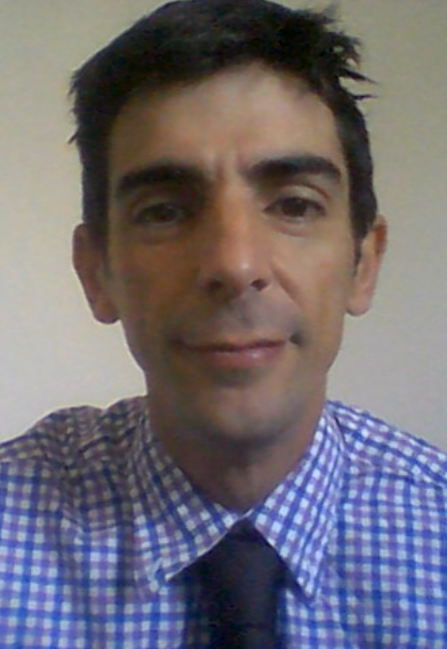
Self introduction
IHO – NIPPON FOUNDATION
ALUMNI SEMINAR
Name | NIKI SILVERA
Alumni year | 2010
Country | URUGUAY
Organization | SOHMA SERVICE OCEANOGRAPHIC HYDROGRAPHIC AND METEOROLOGICAL OF THE URUGUAYAN NAVY
Position/Job title | OFFICER OF THE NAVY CAPTAIN, HEAD OF HYDROGRAPHIC DEPARMENT
Current job description | AS HEAD OF HYDROGRAPHIC DEPARMENT GENERAL PLANNING OF HYDROGRAPHIC SURVEYS, PROCESSING OF FIELD INFORMATION, AND IMPLEMMENTATION OF CARTOGRAPHIC SCHEME
Please put your photo here!

Slide 3
My career path and projects / Achievements
IHO – NIPPON FOUNDATION
ALUMNI SEMINAR
AFTER THE COURSE 2010
DESIGNATED AS HEAD OF DATA PROCESSING DIVISION
SUPERVISOR OF CONTROL CHART QUALITY
EDITOR OF PUBLICATION INT1 SOHMA (Spanish English) year 2012
2012 2015 Operation Chief of HYDROGRAPHIC VESSEL ROU 22 OYARVIDE
2015 until Now
HEAD OF AIDS TO NAVIGATION DEPARTMENT
HEAD OF HYDROGRAPHIC DEPARTMENT SOHMA MANAGMENT OF THREE MAINACTIVITIES , SURVEY, DATA PROCESSING, CARTOGRAPHIC
CHAIR OF PLANNING COMITÉ OF CHATSO Regional Commision Atlantic South

Slide 4
Lessons learned from CHART Course
IHO – NIPPON FOUNDATION
ALUMNI SEMINAR
The COURSE has given me tools to develop knowledge in the area of nautical cartography, paper and electronic.
The COURSE has given me the opportunity to witness the outstanding efficiency in the work carried out by the Hydrographic Office of the United Kingdom, allowing me to apply some experiences in my office.
The learning process was so good that it allowed me in a short time to incorporate and apply the knowledge in the department of hydrography of SOHMA, I can emphasize that upon my return from the course one of my first tasks was the edition of the Book of Symbols and Abbreviations whose previous SOHMA edition dated from 1994. Ar that time when I star to work in the New edition I felt as I had borned with that book, was a sparked of knowledge. was if I have been working with charts along all my life.

Slide 5
Lessons learned from CHART Course
IHO – NIPPON FOUNDATION
ALUMNI SEMINAR
The possibility of cultural exchange with other people of the World, where we were able to live along the course with students from other countries.

Slide 6
Suggestion for the future
IHO – NIPPON FOUNDATION
ALUMNI SEMINAR
The integration of the theory and practice in the course was excellent allowing us to incorporate and apply the knowledge learned in a short time, at the same time it was developed in an environment of respect and friendship, so I would have nothing to suggest, only the desire that The course be maintained to give the possibility to other students and other countries to access to a good preparation, allowing at the same time that once alumni back in their services they generate products that allow ships to navigate their waters on safety way using the charts that have been created by qualified personnel. The maritime navigation is the beneficiary of a good training course like this , where I had the great fortune to access

